Slide 1
Descriptive Statistics

Slide 2
Descriptive Statistics
Descriptive statistics helps to simplify large amounts of data in a sensible way.
In descriptive statistics we do not draw conclusions beyond the data we are analyzing; neither do we reach any conclusions regarding hypotheses we may make

Slide 3
Population and Sample
a population is a collection of objects, items (“units”) about which information is sought;
a sample is a part of the population that is observed.

Slide 4
Data Preparation
Obtaining the data
Parsing the data
Cleaning the data
Building data structures

Slide 5

A few basic data structures in Python
Python List: The list is a most versatile datatype available in Python which can be written as a list of comma-separated values (items) between square brackets. Important thing about a list is that items in a list need not be of the same type.

Slide 6

A few basic data structures in Python
Python Dictionary: It is a key-value store. Each key is separated from its value by a colon (:), the items are separated by commas, and the whole thing is enclosed in curly braces. An empty dictionary without any items is written with just two curly braces, like this: {}.

Slide 7
Dataset we are using
https://archive.ics.uci.edu/ml/datasets/Adult

Slide 8
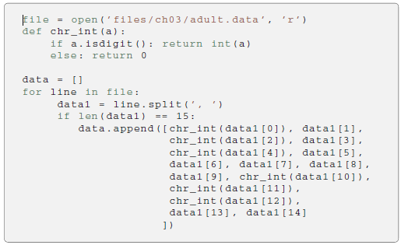
Parsing the data

Slide 9
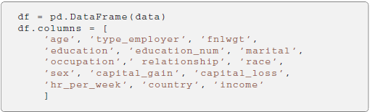
Building Data Structures
Using Panda’s DataFrame structure
It is a two-dimensional, size-mutable, potentially heterogeneous tabular data structure with labeled axes.

Slide 10
A few important commands
df.shape (returns rows and columns)
counts = df.groupby(’country’).size()
print counts.head ()
(The first row shows the number of samples with unknown country, followed by the number of samples corresponding to the first countries in the dataset.)

Slide 11
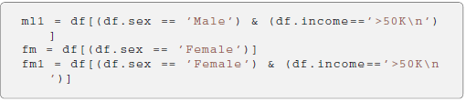
Splitting the dataset

Slide 12
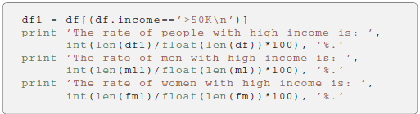
Exploratory Data Analysis
Data can be categorical or quantitative
Summarizing the data
For categorical data, a simple tabulation of the frequency of each category is the best non-graphical exploration for data analysis.

Slide 13
Exploratory Data Analysis
Given a quantitative variable, exploratory data analysis is a way to make preliminary assessments about the population distribution of the variable using the data of the observed samples.
The characteristics of the population distribution of a quantitative variable are its mean, deviation, histograms, outliers, etc.

Slide 14

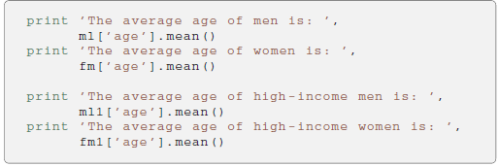
Sample Mean

Slide 15

Sample Variance
Mean Squared Deviation
Square root of the variance is standard deviation

Slide 16
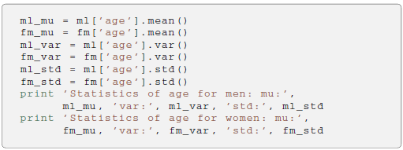

Applying Variance

Slide 17
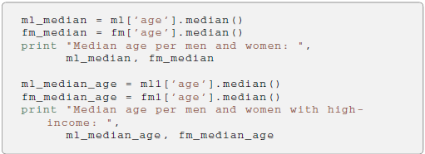
Sample Median
Mean can be affected by outliers.
Median is giving the middle value of a sample.

Slide 18
Quantiles and Percentiles
The k-th percentile of a set of values divides them so that k% of the values lie below and (1-k)% of the values lie above.
The 25-th percentile is the lower quartile.
The 50-th percentile is the median.
The 75-th percentile is the upper quartile.
Quantiles are the same as percentiles but are indexed by sample fractions rather than by sample percentage.

